Slide 1
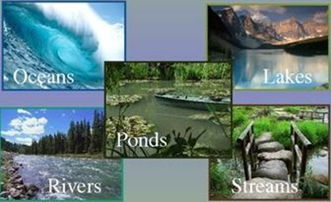
OUR WATER RESOURCES
What is water resources?
Water resources are natural resources of water that are potentially useful for humans.

Slide 2
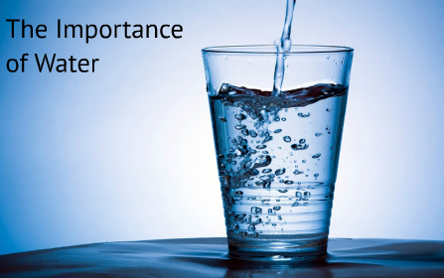
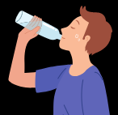
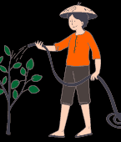
Water is an essential source for the existence of life on the planet earth.
Water is one of the natural resources, which are found in an adequate amount.
It is widely used for various purposes such as drinking, washing, bathing, cleaning, cooking, irrigation, and other industrial and domestic uses.

Slide 3
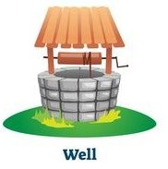
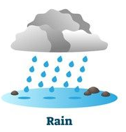
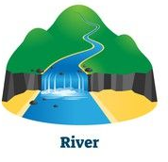
Sources of water
The 5 Five main sources of water are

Slide 4
Fresh water
Rivers, Lakes, underground water and snow are the sources of fresh water.
Rain water is the main source of fresh water.
Farmers In India are dependent on rain water to irrigate their fields.
Rain fall is not uniform in our country.
Some places like Meghalaya get heavy rain and some places like Rajasthan get less or no rain.

Slide 5
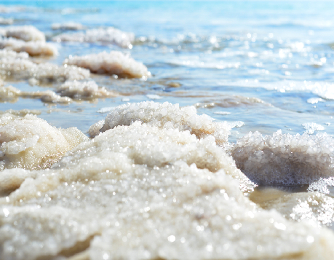
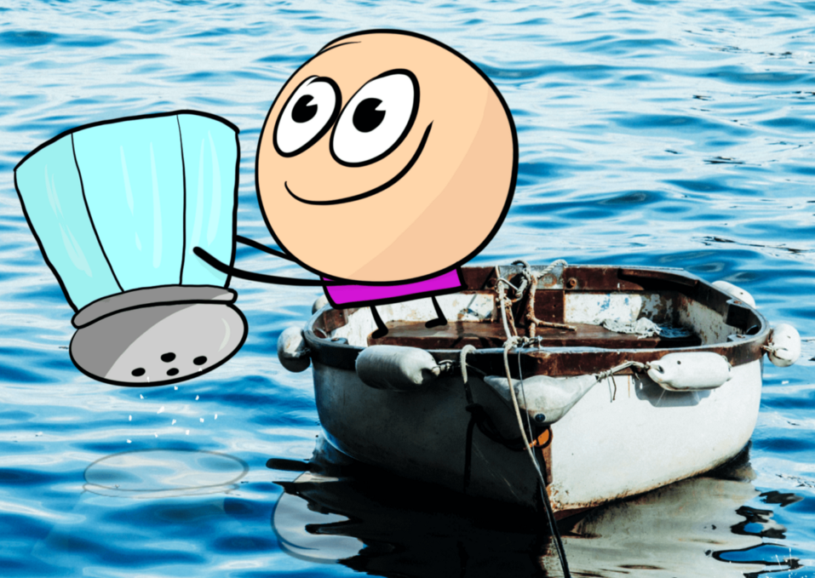
Ocean and Sea water
97 % of earth is covered with water but they are not fit for anything as they are very salty.
Only 3% of water on earth is potable.

Slide 6
Types of irrigation

Slide 7
Water storage
Water storage refers to holding water in an area for a period of time. Water storage can be natural and artificial.
Some of water storages are dams, lakes, ponds, wells, reservoirs, rain water harvesting tanks etc.,
Why do we store water?
Water is so essential to our existence. Water is an important part of our life. Not just humans all living things such as plants and animals need water.
All the water we get comes from the rain. The rainy season lasts for few month. If we do not store water, we will not have enough water for our needs. That is why we should store water.

Slide 8
Brain storming

Slide 9
Thankyou

